Slide 1
US/JAPAN Accelerator R&D
Thirty Years of Collaboration
JLC/NLC/ILC
Gregory Loew
30th Anniversary Symposium
Kona, Hawaii, October 19-22, 2010

Slide 2
Broad Chronology
Phase 1: The Early Years, 1979 – 1985
RF Superconductivity (with M. Tigner at Cornell, and Y. Kojima at KEK)
150 MW S-Band Klystron Program (with G. Konrad at SLAC, J. Tanaka at KEK, and Mitsubishi/Toshiba)
Surface Physics for RF Sources and Klystron Windows
Phase 2: 1986 – Present
Linear Collider R&D
Annual HEP Meetings alternated between US and Japan, except for 1992 meeting in Kona, Hawaii
Starting in 1987, Annual Collaboration LC Workshops alternated between KEK and SLAC
June 1990: Sugawara and Richter decided to focus on 500 GeV c.m. LC
between KEK and SLAC and speed up exchanges

Slide 3
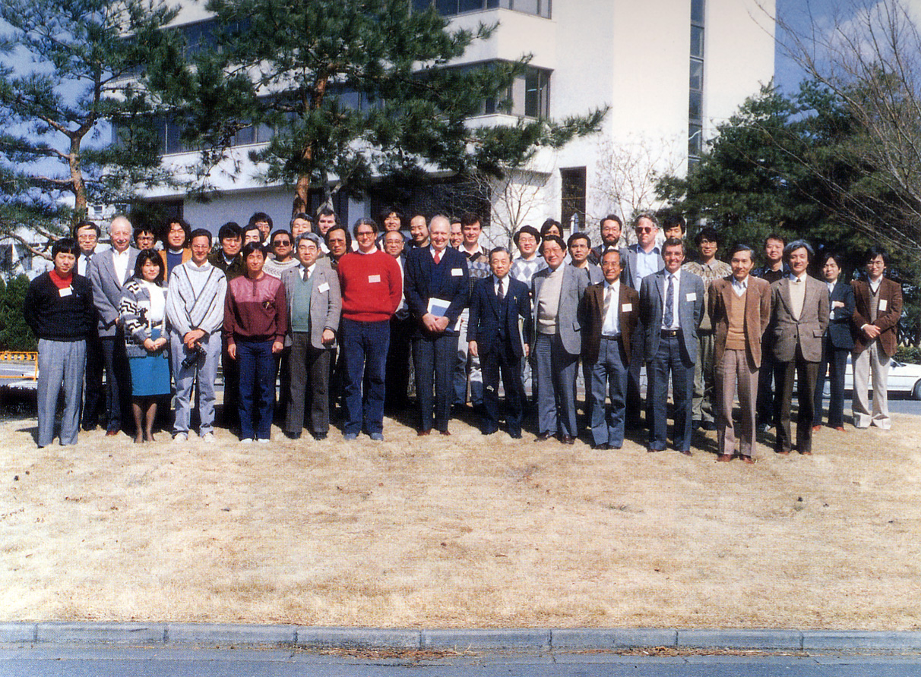
KEK/SLAC LC WORKSHOP
March 1-4, 1988 at KEK

Slide 4
Major Participants, starting at 1988 KEK Workshop
Y. Kimura ( KEK Co-Chair)
T. Nishikawa
S. Ozaki
S. Iwata
S. Kamada
K. Yokoya
S. Kurokawa
H. Mizuno
T. Shintake
T. Shidara
K. Takata
S. Takeda
M. Yoshioka
K. Oide
And many others
G . Loew (SLAC Co-Chair)
B. Richter
J. Paterson
R. Ruth
M. Allen
J. Sheppard
N. Toge
R. Palmer
H. Matsumoto
J. Urakawa
H. Hayano
T. Higo
N. Sasao
H. Fukuma
M. Akemoto
N. Yamamoto
K. Akai
K. Hagiwara
Y. Takeuchi
S. Hiramatsu
K. Kubo
Later joined by:
D. Burke
T. Raubenheimer
J. Wang
G. Spalek
T. Lee
T. Lavine
H. Hoag
J. Frisch
A. Vlieks
G. Bowden
N. Phinney
Marc Ross
S. Tantawi
D. McCormick
K. Jobe
T. Smith
P. Tenenbaum
D. Yeremian
C.Adolphsen

Slide 5
Major Highlights of R&D Collaboration
Klystrons with Solenoid and PPM Focusing
Accelerator Structures, Design, Fabrication, Wakefield and Breakdown Studies
RF Pulse Compression, Cavities and Delay Lines
Klystron Modulator Design
SLAC Final Focus Test Beam with Laser-Compton Profile Monitor
KEK ATF Linac, Damping Ring and Final Focus
SLAC NLC X-Band Test Accelerator
Design of Common Linear Collider
Very important meetings and visitors

Slide 6
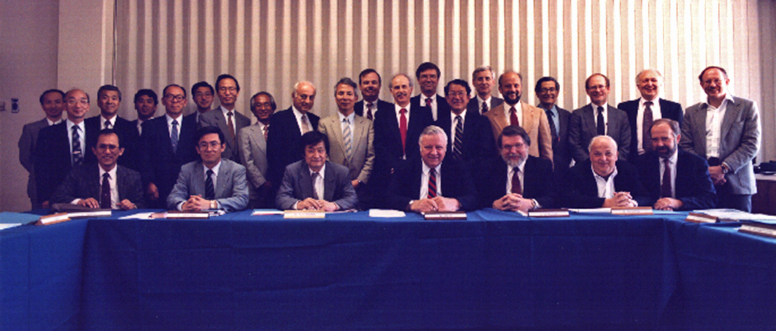
US/JAPAN 1991 Collaboration on HEP
Meeting at SLAC

Slide 7
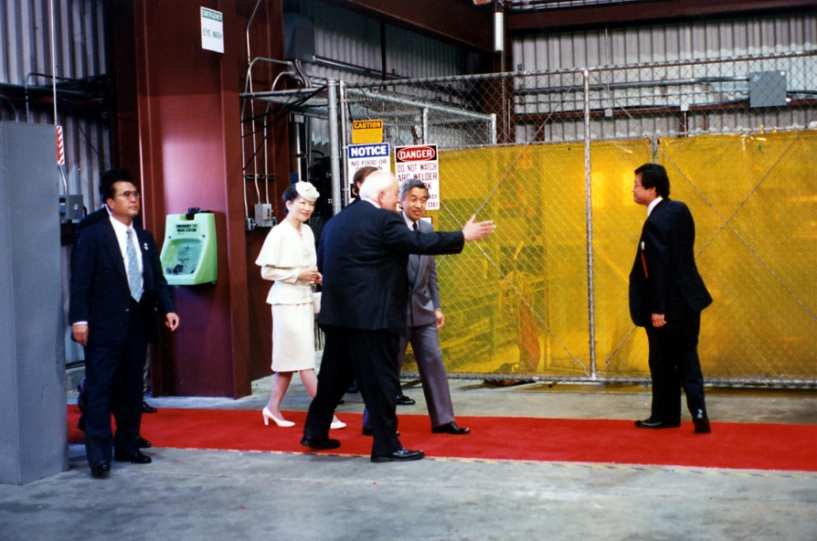
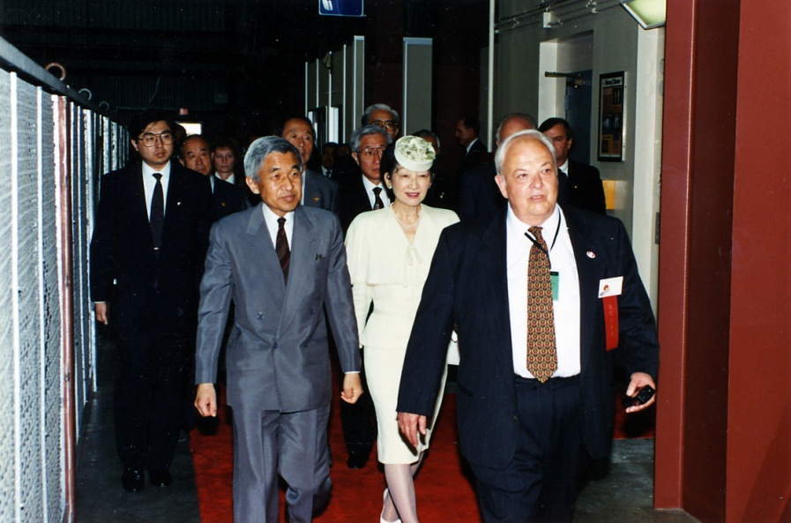
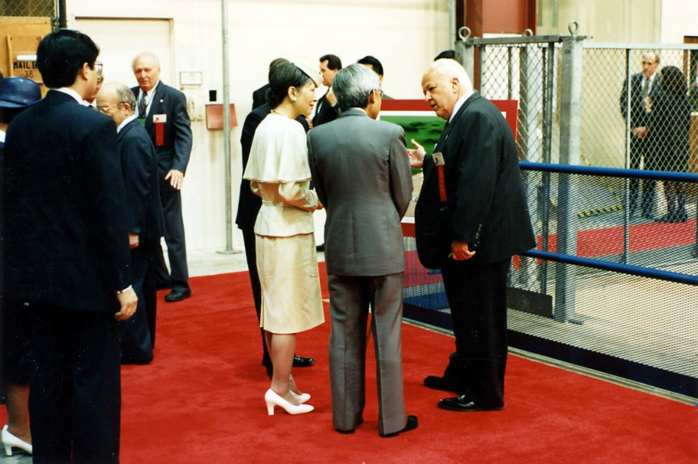
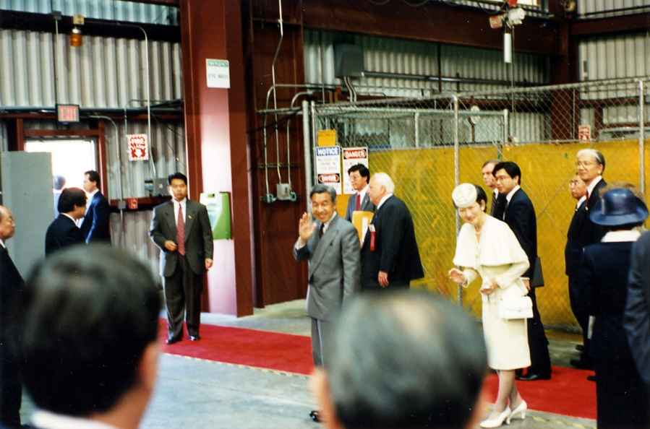
Their Majesties’ Visit at SLAC
June 23, 1994

Slide 8
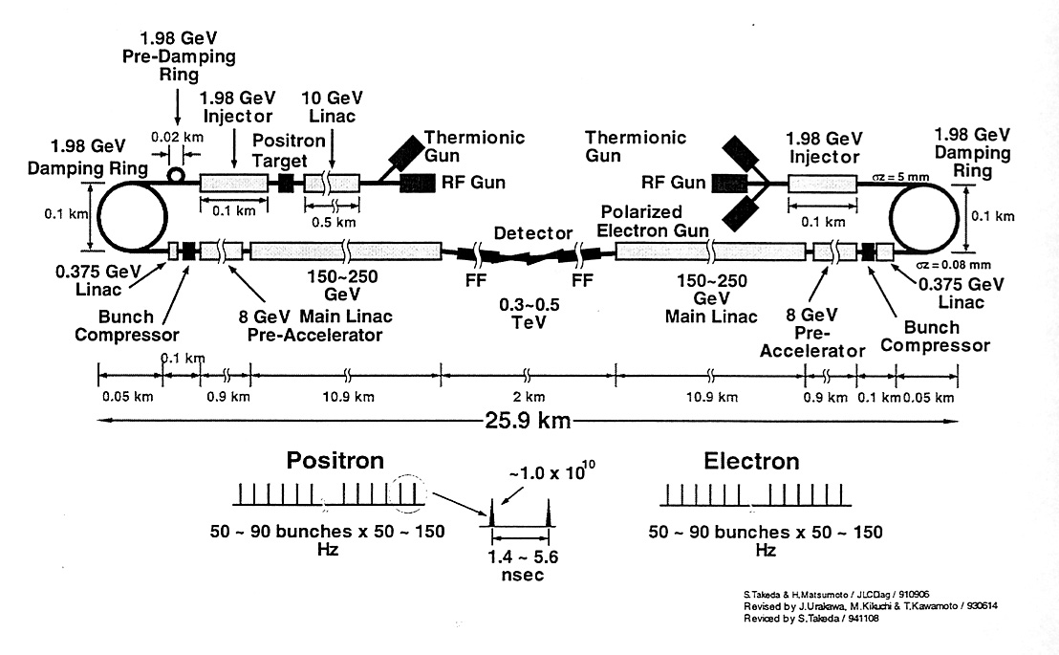
The Original 3 JLC’s in 1995 TRC Report
S-Band, C-Band and X-Band

Slide 9
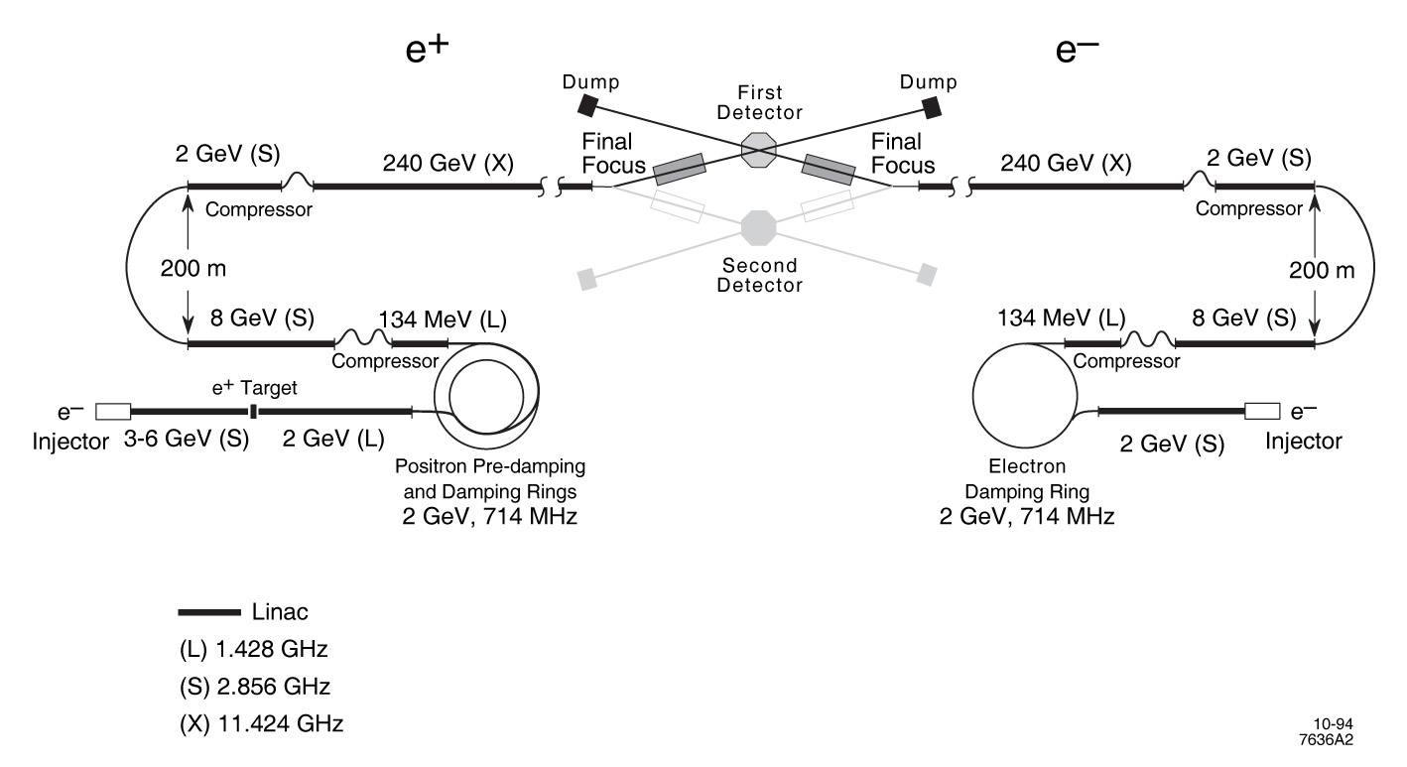
The Original NLC in 1995 TRC Report
X-Band

Slide 10
Major Technical Achievements
1995-2009

Slide 11
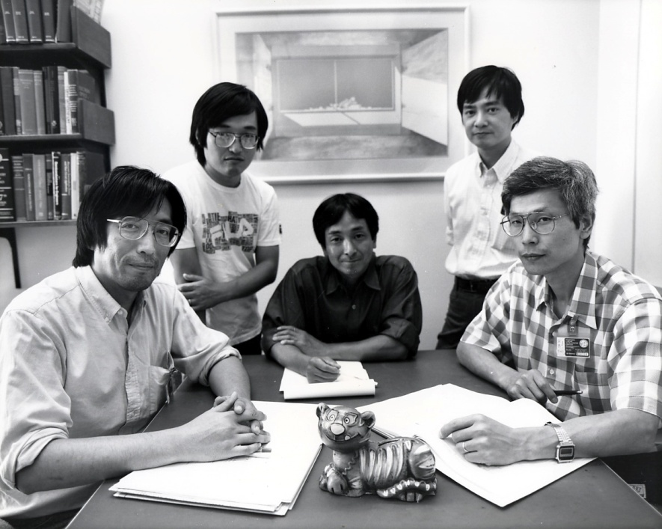
The Junior KEK Brain Trust Visiting SLAC

Slide 12
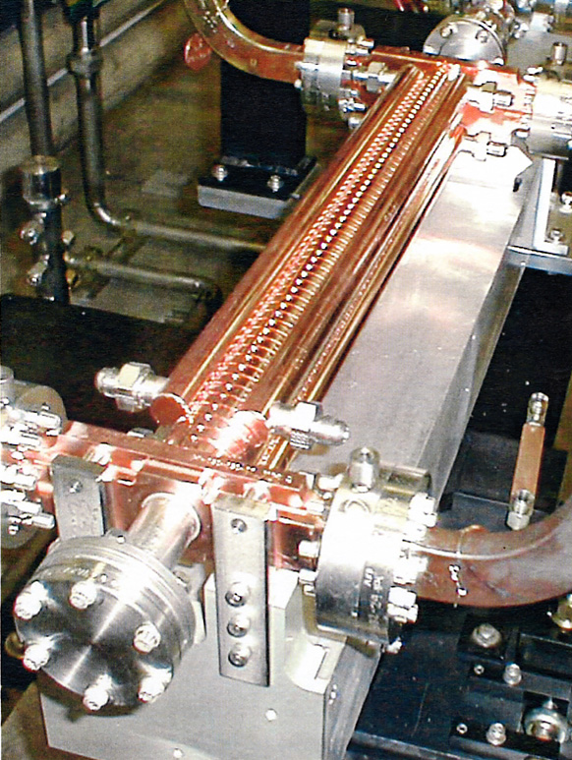
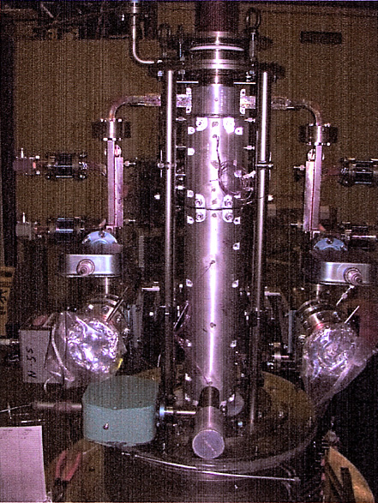
75 MW X-Band Klystron with PPM Focusing
X-Band Linac Section with 80 MV/m
gradient and wakefield suppression

Slide 13
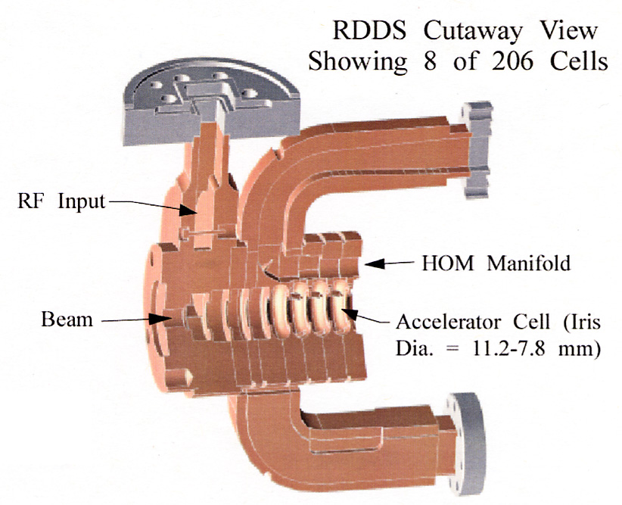
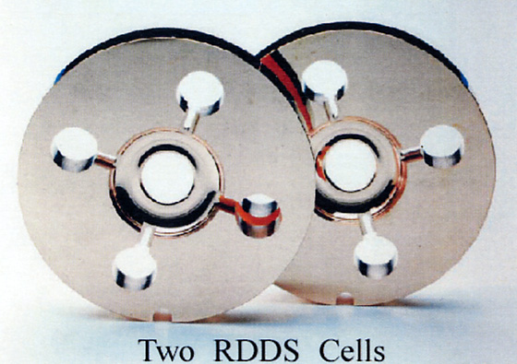
Details of structure design

Slide 14
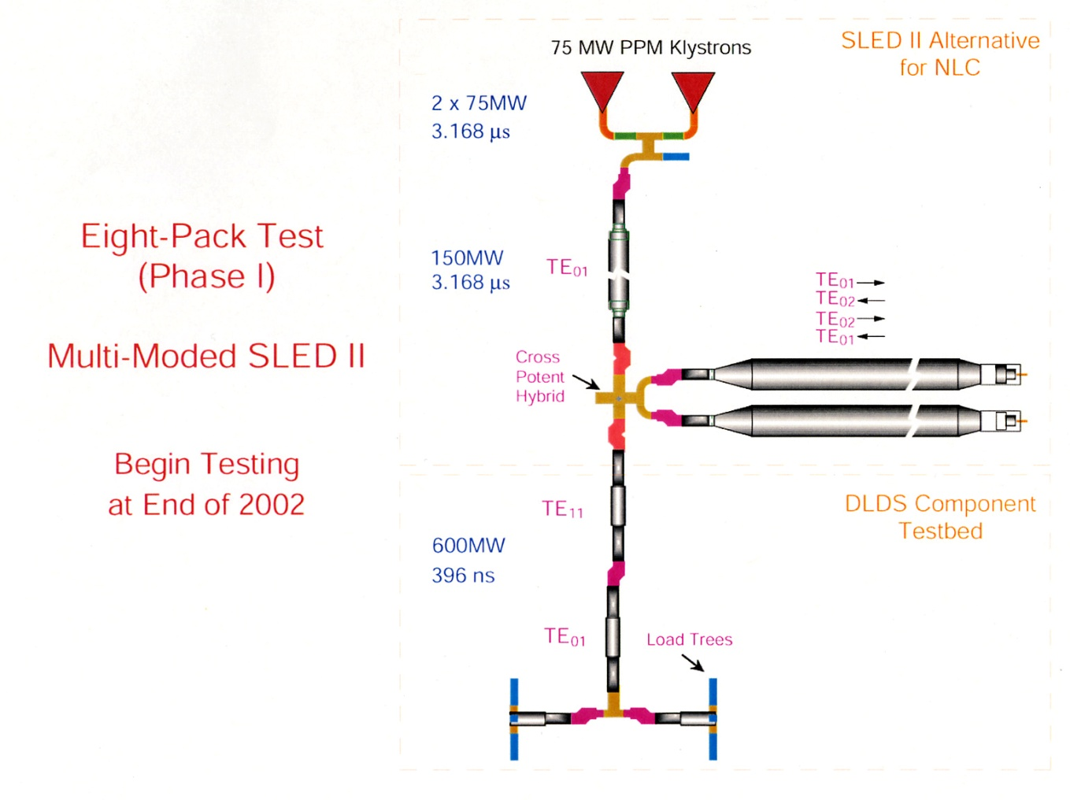
Pulse Compression using Delay Lines producing 600 MW Peak X-Band Power

Slide 15
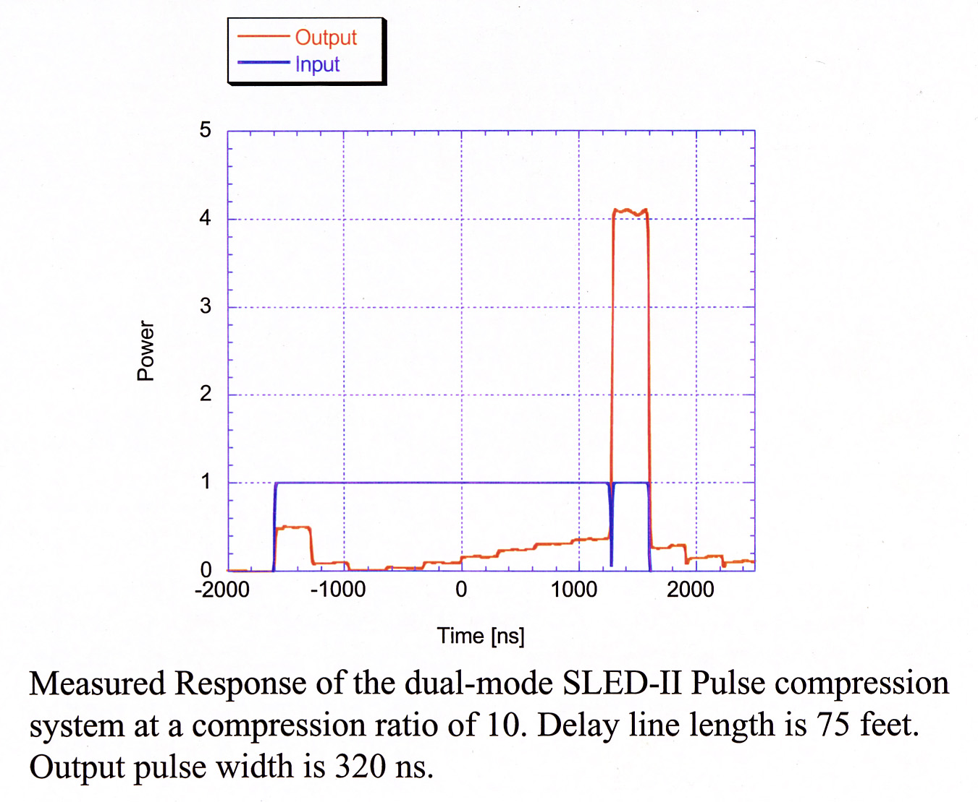
Pulse Compression with X4 Gain

Slide 16
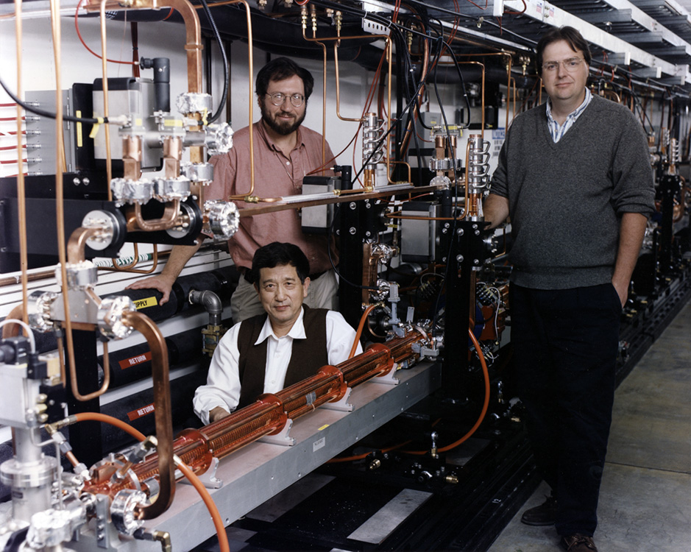
350 MeV NLC X- Band Test Accelerator
J. Wang, T. Lavine and C. Adolphsen

Slide 17
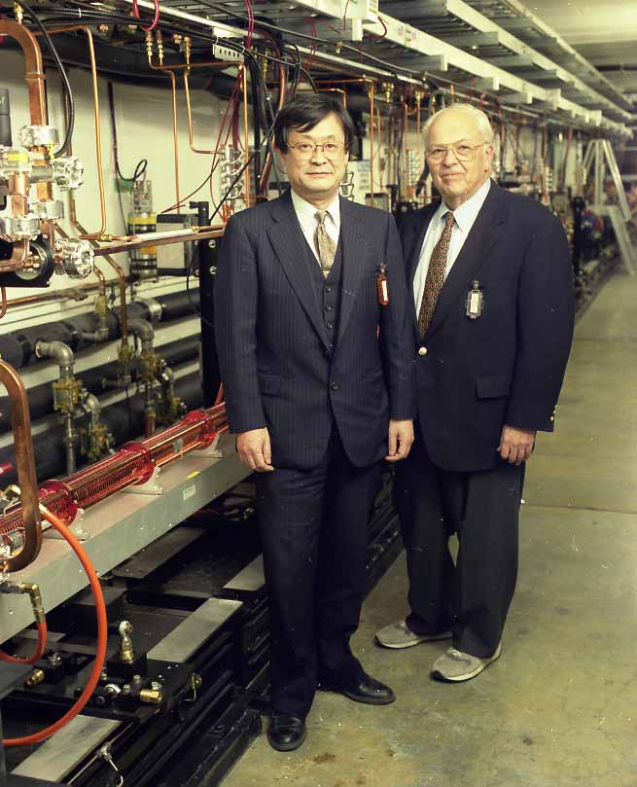
Sugawara and Richter at SLAC’s NLCTA
350 Mev X-Band Linac

Slide 18
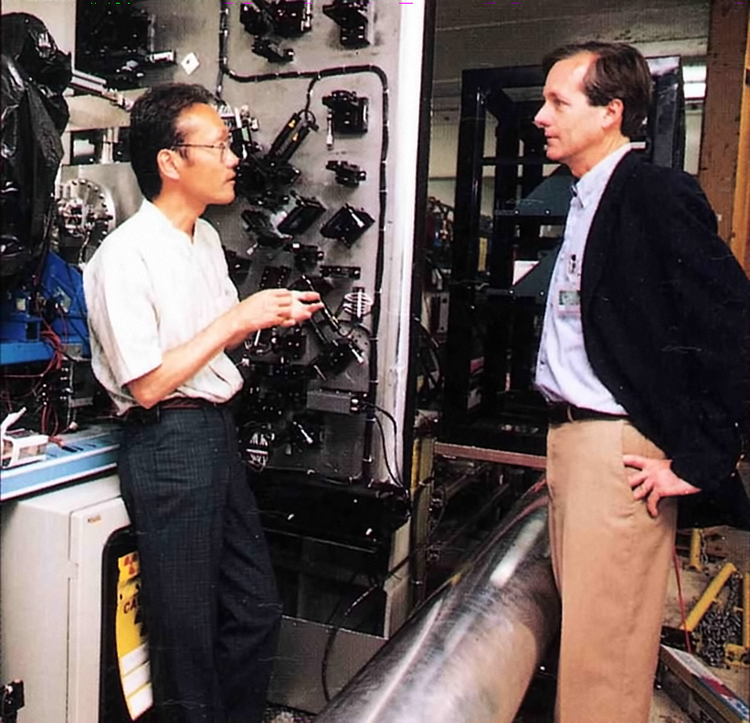
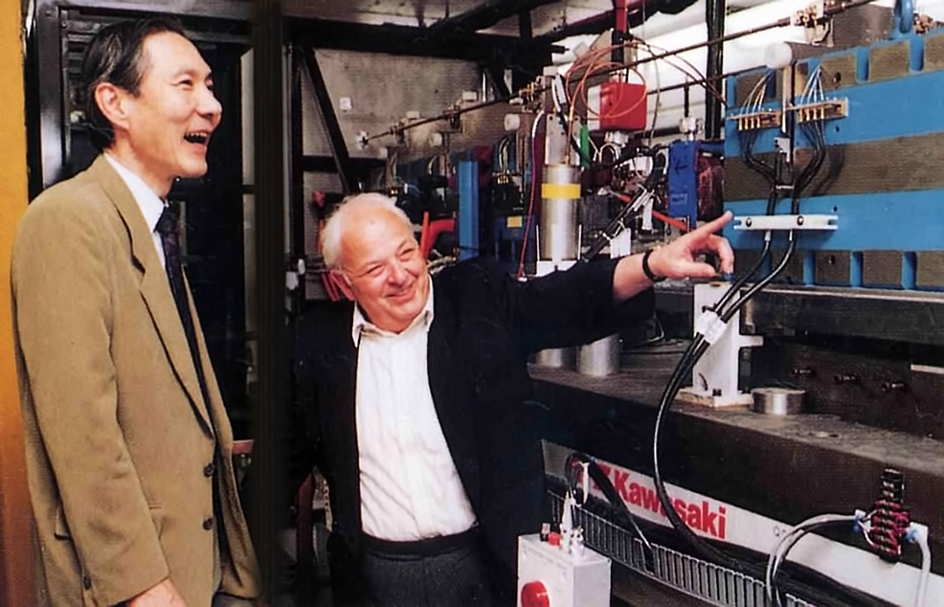
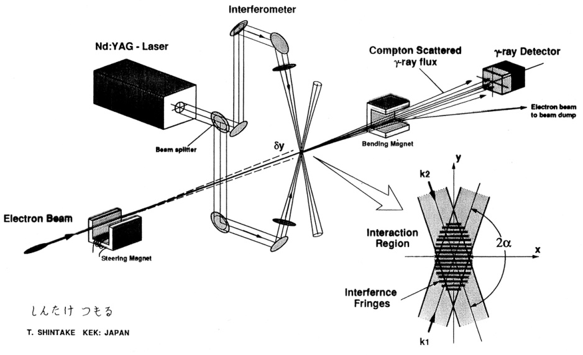
Final Focus Test Beam and
Laser-Compton
Fringe Monitor
Measured sigma y of about 70 nm at 48 GeV

Slide 19
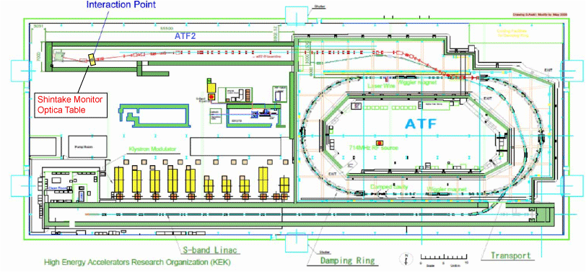
ATF/ATF2 AT KEK
ATF
accelerate electron beam to 1.3 GeV
normalized γε_{y} = 2.8 × 10⁻⁸ m・rad achieved in the Damping Ring
Layout of ATF/ATF2
Goals of ATF2
focus the vertical beam size to 37 nm
stabilize the vertical beam position in 2 nm resolution
Notes:
リニアーコライダーで計画されているビームサイズは垂直方向に約5nmという、まだ実現されたことのないサイズなので、特にビーム収束を試験するための施設が高エネルギー加速器研究機構に建設されました。これはATF及びATF2と呼ばれていまして、ここでは垂直方向のビームサイズを37 nmまで収束することを目標としています。
ここに示した図がATFとATF2のレイアウトですが、図の下側のビームラインが線形加速器でして、1.3 GeVまで電子ビームを加速します。加速したビームはダンピングリングと呼ばれるリングに入射しまして、ここでビームサイズを収束するのに必要なエミッタンスという量を低下させます。エミッタンスを限界まで小さくされたビームは上側のビームラインに取り出されます。ここまでがATFと呼ばれるセクションで、その後の電子ビームの最終収束のラインがATF2と呼ばれるセクションでATFを拡張して新規に建設され、2008年秋には一通り建設作業が完了しました。ここで、最終的にInteraction Pointと示された仮想衝突点で電子ビームが水平垂直両方向に最も小さく収束されます。

Slide 20
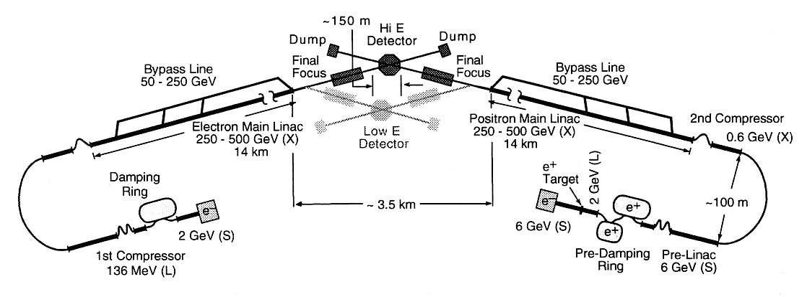
JLC-X/NLC Common Design in 2003 TRC Report

Slide 21
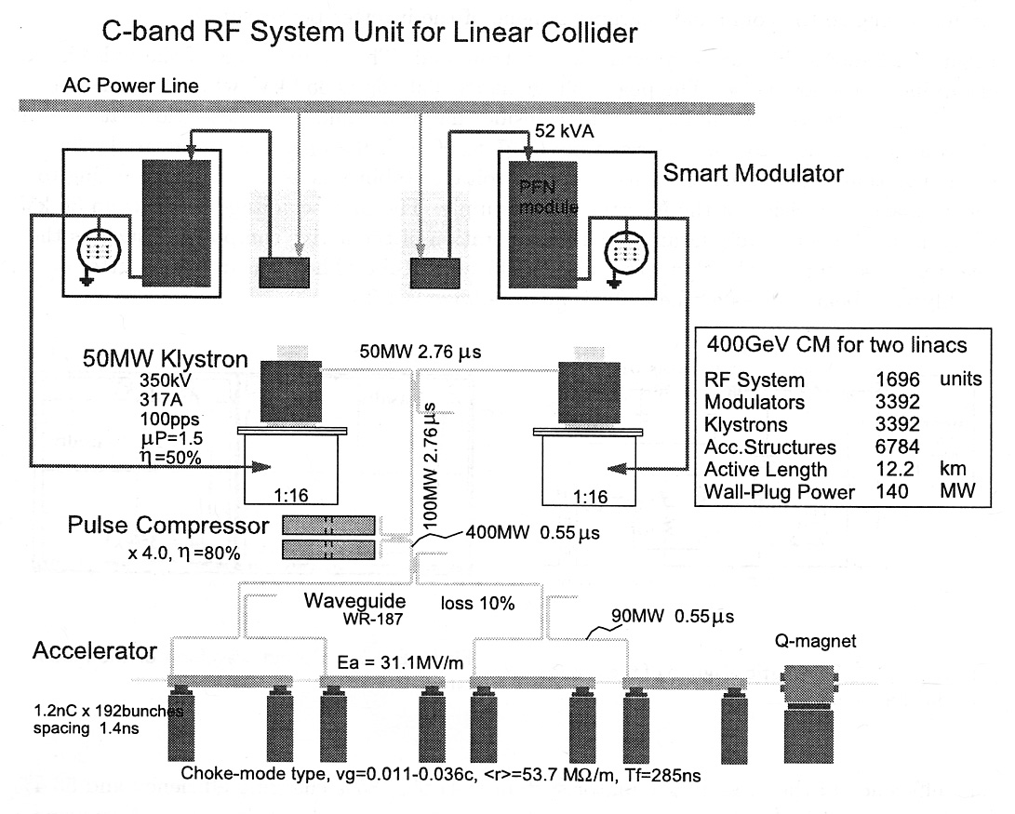
KEK C-Band System Unit for LC in 2003 TRC Report

Slide 22
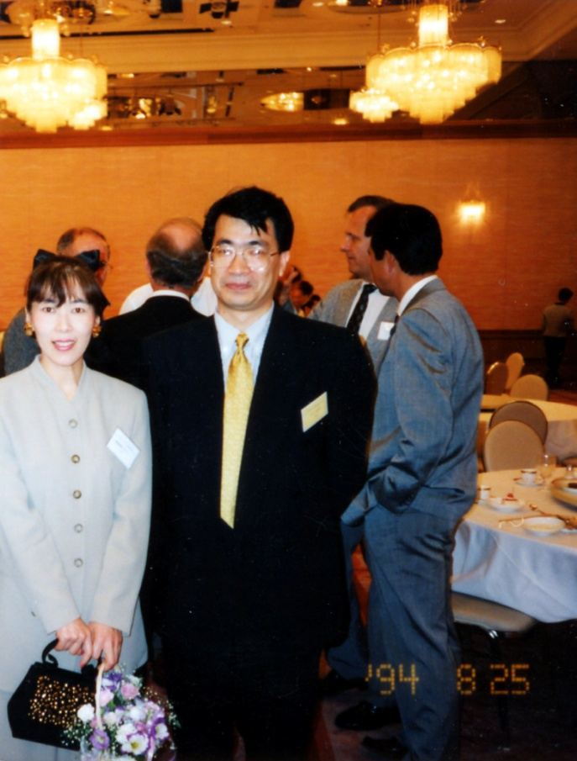
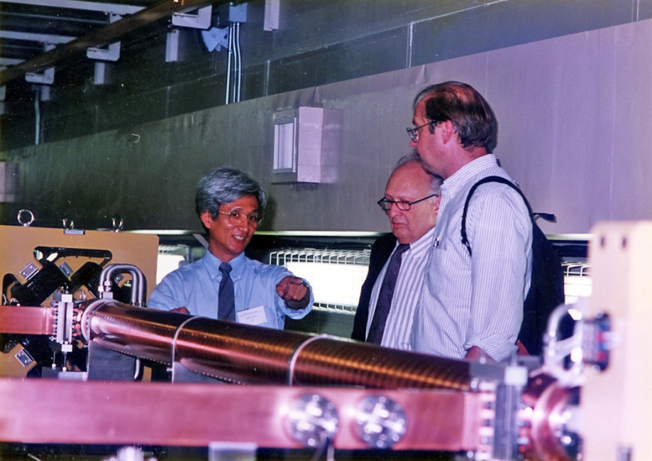
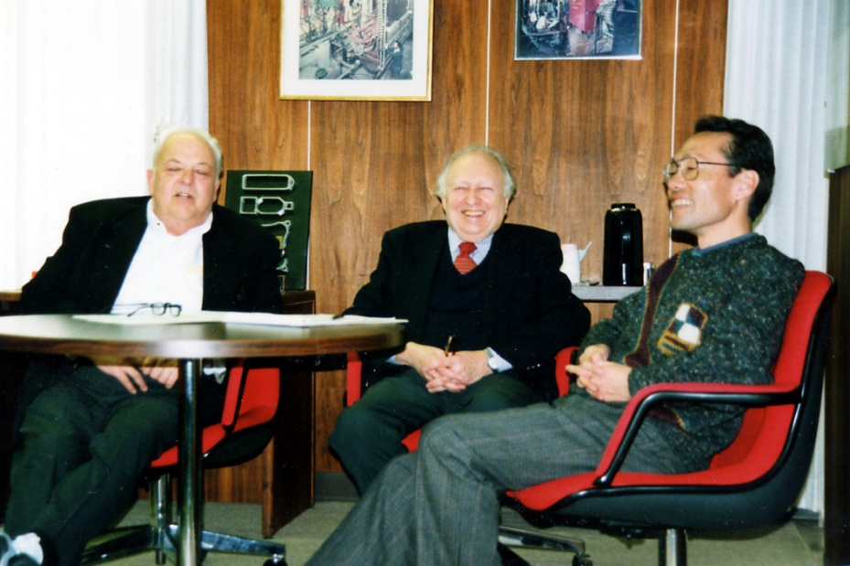
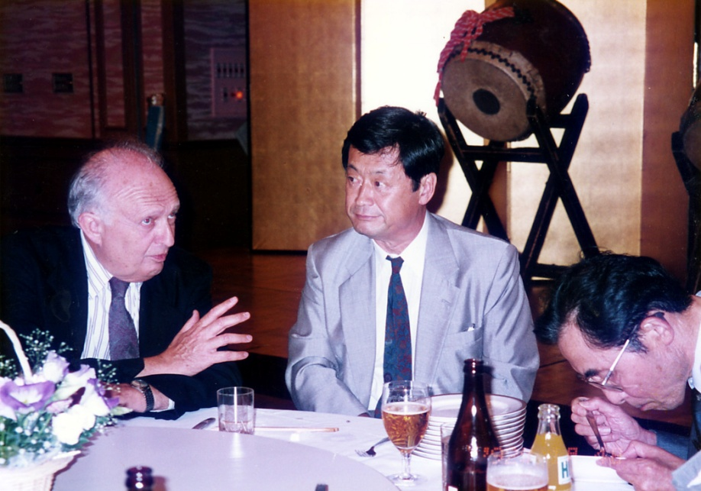
Vignettes

Slide 23
The Fateful Decision!

Slide 24
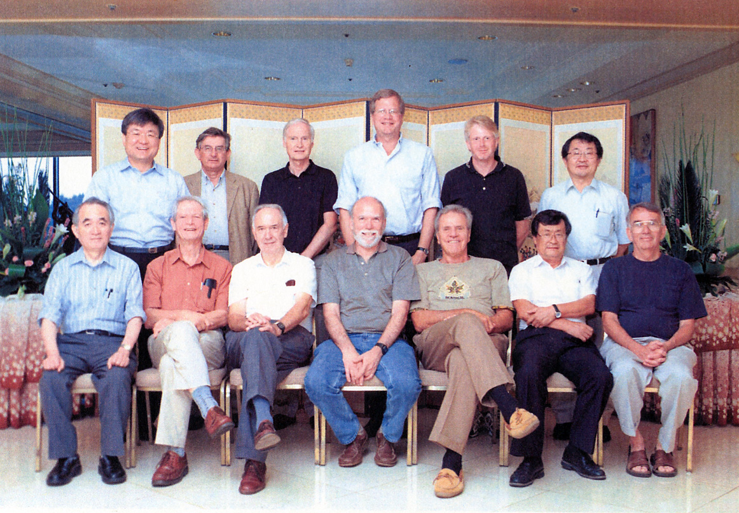
The 13 Cold Guys Sweating it Out
August 11-13, 2004 in Korea

Slide 25
Fast Forward to Today’s ILC

Slide 26
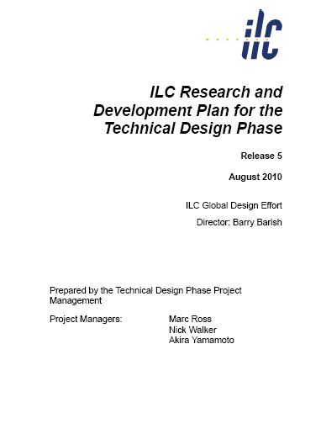

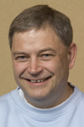
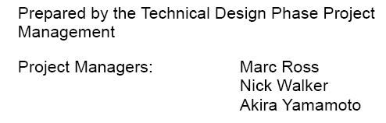
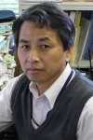
Present Status of R&D Program
US
EUROPE
JAPAN
http://ilc-edmsdirect.desy.de/ilcedmsdirect/file.jsp?edmsid=*813385

Slide 27
Components of the SB2009 Design for Study and Review during 2010.
RDR
SB2009
Single Tunnel for main linac
Move positron source to end of linac
Reduce number of bunches factor of two (lower power)
Reduce size of damping rings (3.2km)
Re-evaluate optimum accelerating gradient
Integrate central region
Single stage bunch compressor
Site dependent optimization

Slide 28
 |  |  |  |  |  |  |  | upgrade
Centre-of-mass energy | E_{cm} | GeV | 200 | 250 | 350 | 500 |  | 1000
Beam energy | E_{beam} | GeV | 100 | 125 | 175 | 250 |  | 500
Lorentz factor | γ |  | 1.96E+05 | 2.45E+05 | 3.42E+05 | 4.89E+05 |  | 9.78E+05
Collision rate | f_{rep} | Hz | 5 | 5 | 5 | 5 |  | 4
Electron linac rate | f_{linac} | Hz | 10 | 10 | 5 | 5 |  | 4
Number of bunches | n_{b} |  | 1312 | 1312 | 1312 | 1312 |  | 2625
Electron bunch population | N₋ | ×10¹⁰ | 2 | 2 | 2 | 2 |  | 2
Positron bunch population | N₊ | ×10¹⁰ | 2 | 2 | 2 | 2 |  | 2
Bunch seperation | Δt_{b} | ns | 740 | 740 | 740 | 740 |  | 356
Bunch seperation ×f_{RF} | Δt_{b} f_{RF} |  | 962 | 962 | 962 | 962 |  | 463
Pulse current | I_{beam} | mA | 4.33 | 4.33 | 4.33 | 4.33 |  | 9.00
RMS bunch length | σ_{z} | mm | 0.3 | 0.3 | 0.3 | 0.3 |  | 0.3
Electron RMS energy spread | Δp/p | % | 0.22 | 0.22 | 0.22 | 0.21 |  | 0.11
Positron RMS energy spread | Δp/p | % | 0.17 | 0.14 | 0.10 | 0.07 |  | 0.04
Electron polarisation | P₋ | % | 80 | 80 | 80 | 80 |  | 80
Positron polarisation | P₊ | % | 31 | 31 | 29 | 22 |  | 22
Horizontal emittance (linac exit) | γε_{x} | μm | 10 | 10 | 10 | 10 |  | 10
Vertical emittance (linac exit) | γε_{y} | nm | 35 | 35 | 35 | 35 |  | 35
IP horizontal beta function | β_{x}* | mm | 16 | 12 | 15 | 11 |  | 30
IP vertical beta function (no TF) | β_{y}* | mm | 0.48 | 0.48 | 0.48 | 0.48 |  | 0.30
IP vertical beta function (TF) | β_{y}* | mm | 0.2 | 0.2 | 0.2 | 0.2 |  | 0.2
IP RMS horizontal beam size | σ_{x}* | nm | 904 | 700 | 662 | 474 |  | 554
IP RMS veritcal beam size (no TF) | σ_{y}* | nm | 9.3 | 8.3 | 7.0 | 5.9 |  | 3.3
IP RMS veritcal beam size (TF) | σ_{y}* | nm | 6.0 | 5.3 | 4.5 | 3.8 |  | 2.7
Horizontal distruption parameter | D_{x} |  | 0.2 | 0.3 | 0.2 | 0.3 |  | 0.1
Vertical disruption parameter | D_{y} |  | 20.7 | 23.8 | 21.3 | 24.9 |  | 19.2
Horizontal enhancement factor | H_{Dx} |  | 1.1 | 1.1 | 1.1 | 1.2 |  | 1.0
Vertical enhancement factor | H_{Dy} |  | 5.7 | 6.0 | 5.8 | 6.1 |  | 3.6
Total enhancement factor | H_{D} |  | 1.8 | 1.9 | 1.8 | 2.0 |  | 1.5
Geometric luminosity | L_{geom} | ×10³⁴ cm⁻²s⁻¹ | 0.2 | 0.4 | 0.5 | 0.8 |  | 1.8
Luminosity | L | ×10³⁴ cm⁻²s⁻² | 0.5 | 0.7 | 0.8 | 1.5 |  | 2.8
Fraction of luminosity in top 1% | L_{0.01}/L |  |  | 0.96 | 0.88 | 0.73
Average beamstrahlung parameter | Υ_{av} |  | 0.013 | 0.021 | 0.032 | 0.063 |  | 0.109
Maximum beamstrahlung parameter | Υ_{max} |  | 0.032 | 0.051 | 0.075 | 0.150 |  | 0.260
Average number of photons / particle | n_{γ} |  | 0.96 | 1.22 | 1.28 | 1.74 |  | 1.46
Average energy loss | δE_{BS} | % | 0.53 | 1.04 | 1.55 | 3.76 |  | 4.83
Number of pairs per bunch crossing | N_{pair} | ×10³ |  | 97.4 | 214 | 494
Luminosity | L | ×10³⁴ cm⁻²s⁻² | 0.5 | 0.8 | 1.0 | 2.0
Average energy loss | δE_{BS} | % |  | 0.6 | 1.6 | 3.6
Number of pairs per bunch crossing | N_{pair} | ×10³ |  | 115 | 255 | 596
Fraction of luminosity in top 1% | L_{0.01}/L |  |  | 0.89 | 0.77 | 0.72
Current ILC Parameters

Slide 29
From R&D Programs to TLCC Process
Top Level Change Control
Baseline Assessment Workshops
  Face to face meetings
  Open to all stakeholders
  Plenary
BAW-1 Successfully completed and PM’s have forwarded recommendations to Project Director for TLCC
 | When | Where | What
BAW 1 | Sept. 7-10, 2010 | KEK | Accelerating Gradient Single Tunnel (HLRF)
BAW 2 | Jan 18-21, 2011 | SLAC | Reduced RF e+ source location
Recommend :- No change in gradient, Single tunnel linac and continuing development of alternate RF power systems, Klystron Cluster and Distributed RF.

Slide 30

A Review on Design Study of the
ILC Conventional Facility in Mountain Region
One Example of Site Dependent Optimization
Process and Input to BAW-1

Slide 31
International Review of ILC Facility in Mountain Region
Review Chair: Victor R. Kuchler (GDE-CFS: FNAL)
Reviewers: John A. Osborne (GDE-CFS: CERN)
Thomas W. Lackowski (GDE-CFS FNAL)
Larry L. Hammond (GDE-CFS: FNAL)
Randal J. Wielgos (GDE-CFS: FNAL)
Tracy Lundin (Hanson Professional Service Inc.)
Wilhelm Bialowons (GDE-CFS/GS-APM: DESY)
Tomoki Shiotani (Kyoto U.)
Takafumi Seiki (Utsunomiya U.)
Hideaki Yasuhara (Ehime U.)
Satoru Yamashita (U. Tokyo)
Observer Tomofumi Koyama (Kyoto U.)
Assistant/Secretary: Akira Yamamoto (GDE/KEK/AAA)

Slide 32
Good Luck to the Next Generation!

